Slide 1
Top Down Parsing
Instructor: Dr. Shamim H Ripon
Course: CSE375, Compiler Design

Slide 2
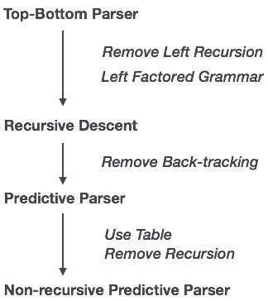
Top-Down Parsing Flow

Slide 3
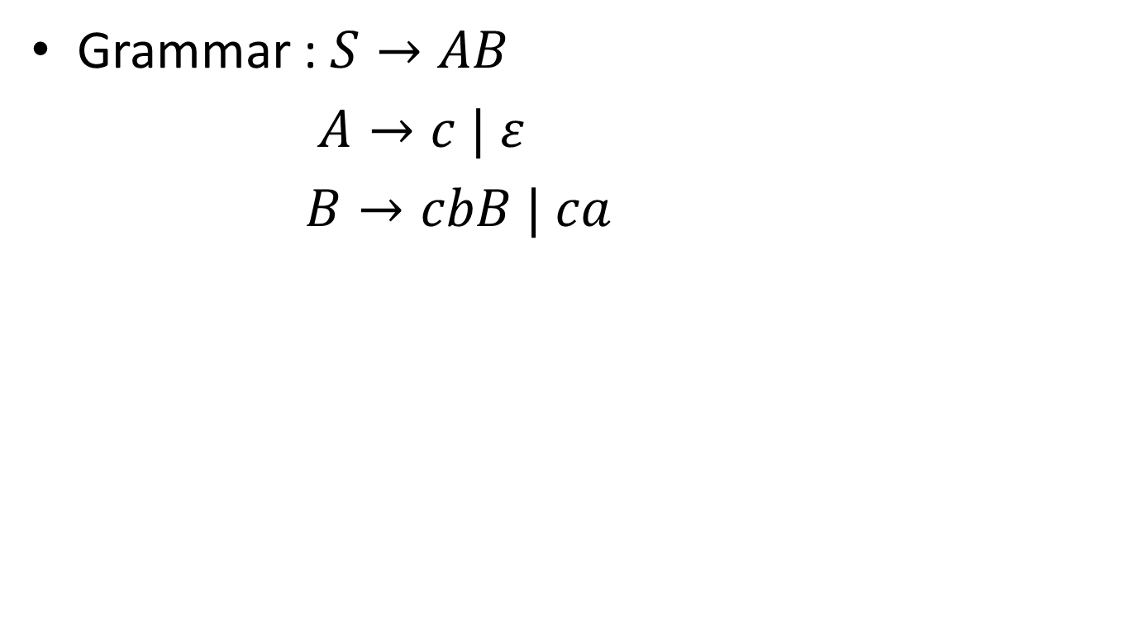
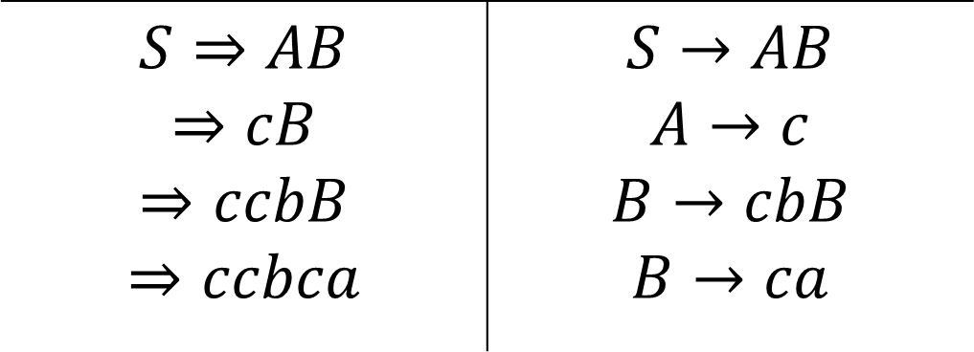
Top-down parsing
Input String: ccbca

Slide 4
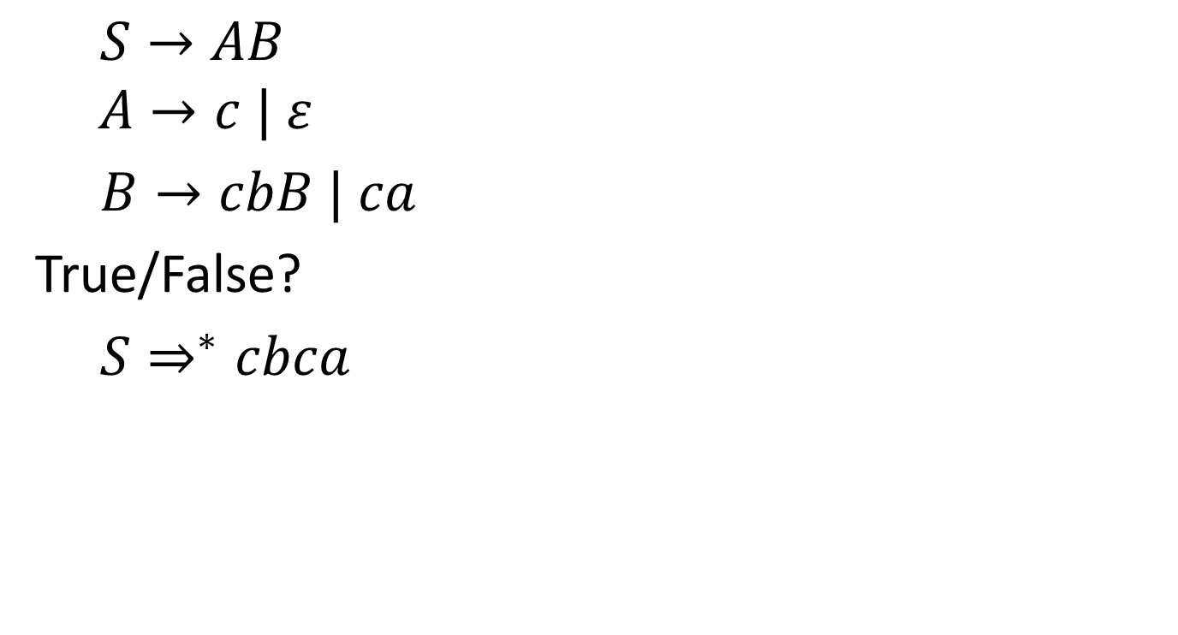
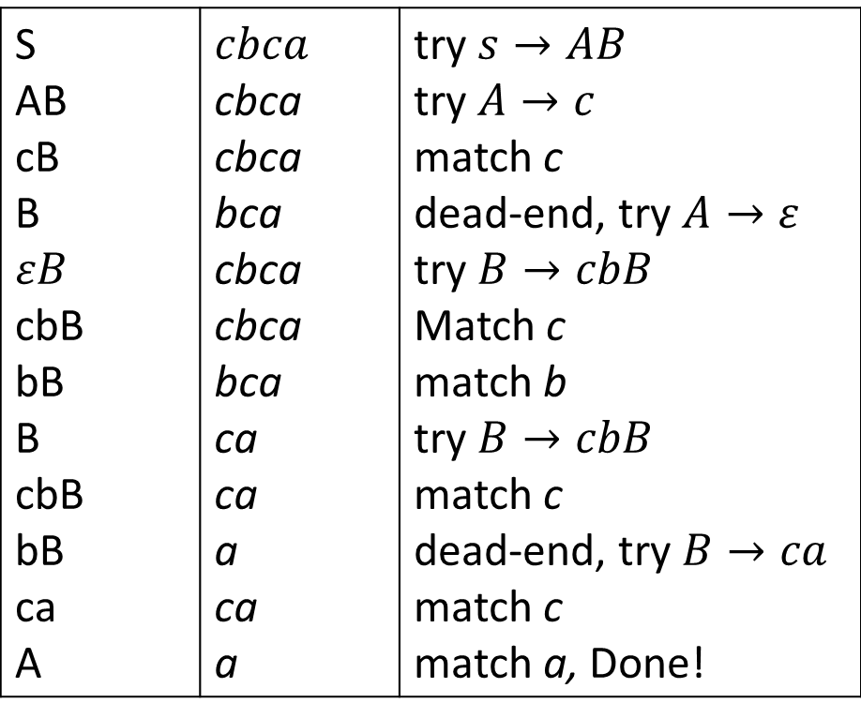
Top-down: Backtracking

Slide 5
Outline
Left Recursion
Elimination
Left factoring
Predictive Parsing
First and Follow
Construction of Parse Table
Predictive Parsing Example

Slide 6
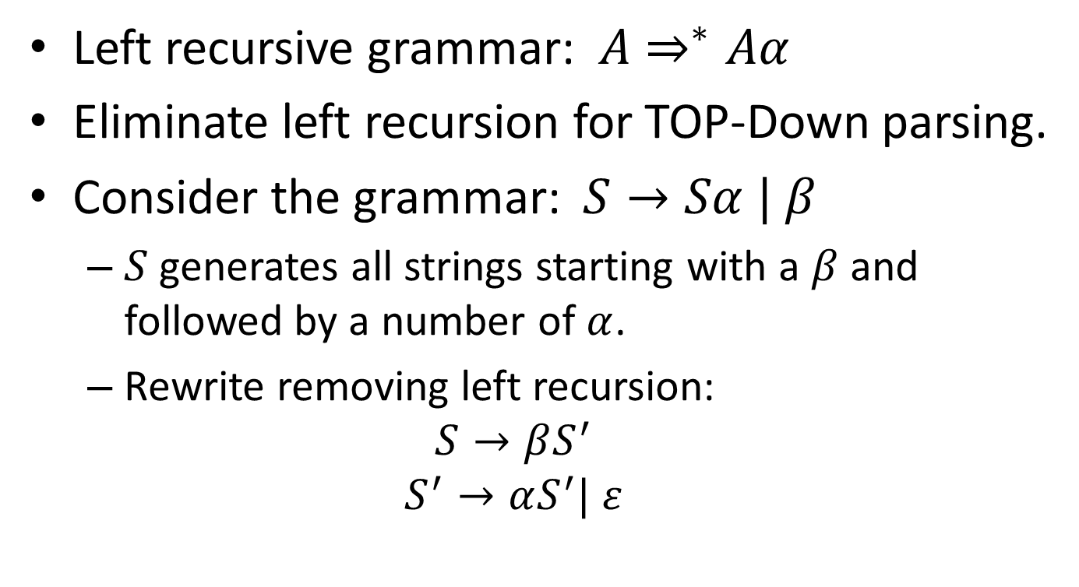
Left Recursion
Left recursive grammar:$A⇒^{∗}Aα$
Eliminate left recursion for TOP-Down parsing.
Consider the grammar: $S→Sα | β$
$S$ generates all strings starting with a $β$ and followed by a number of $α$.
Rewrite removing left recursion:
$$S→βS^{′}$$
$$S^{′}→αS^{′}| ε$$

Slide 7

Left Recursion
Ingeneral:
$$S→Sα_{1} \left| …\right|Sα_{n}\left| β_{1}\right|…| β_{m}$$
Rewrite as,
$$S→β_{1}S^{′}|…|β_{m}S^{′}$$
$$S^{′}→α_{1}S^{′}|…|α_{n}S′$$

Slide 8
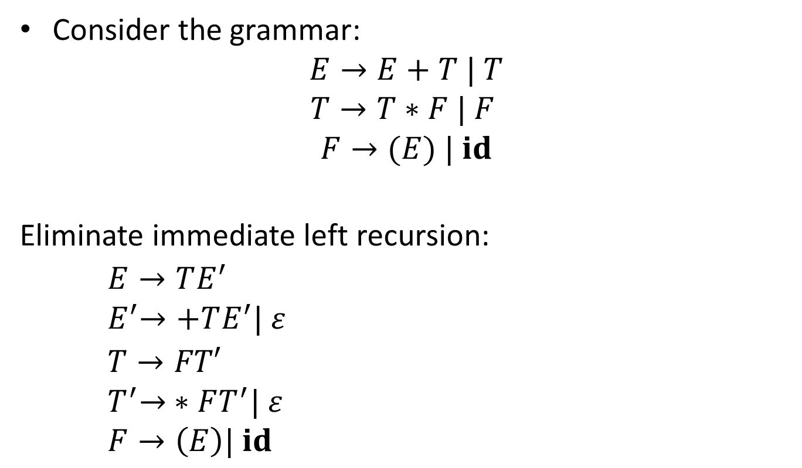
Eliminate Left Recursion
Consider the grammar:
$$E→E+T | T$$
$$T→T∗F | F$$
$$F→(E) | id$$
Eliminate immediate left recursion:
$E→TE^{′}$
$${ E}^{′}→+TE^{′}| ε$$
$T→FT′$
$${ T}^{′}→ ∗FT^{′}| ε$$
$$F→\left(E\right)| id$$

Slide 9
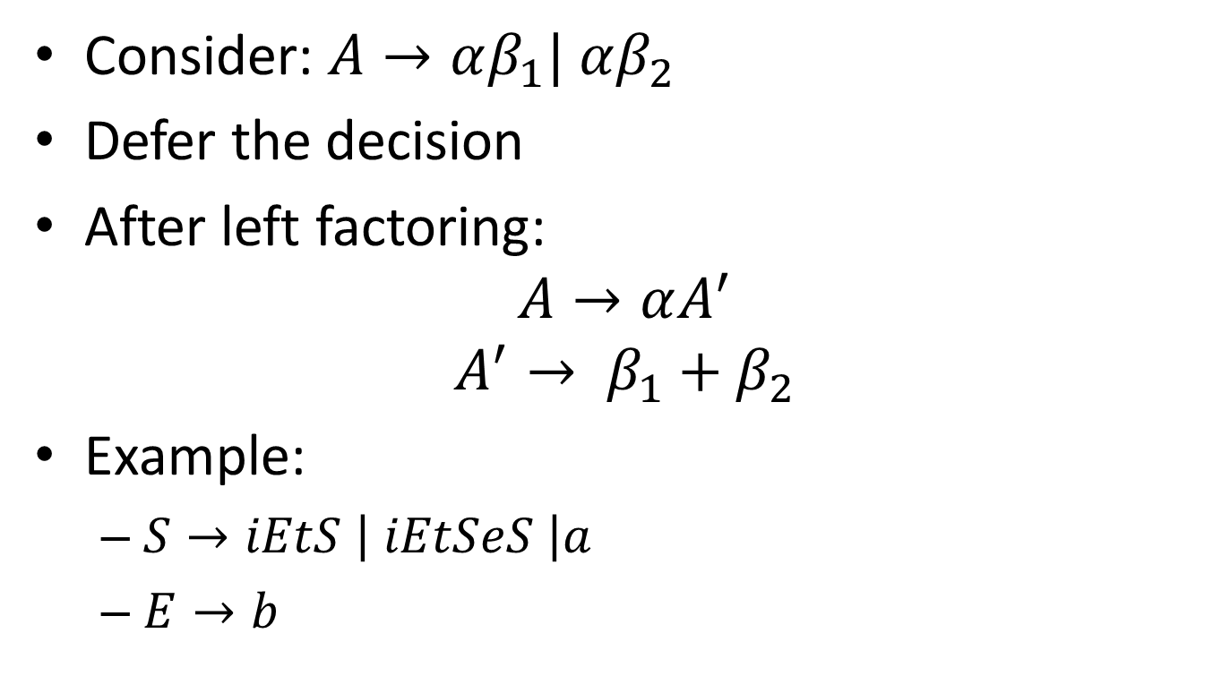
Left Factoring
Consider: $A→αβ_{1}| αβ_{2}$
Defer the decision
After left factoring:
$$A→αA^{′}$$
$$A^{′}→ β_{1}+β_{2}$$
Example:
$S→iEtS \left| iEtSeS \right|a$
$E→b$

Slide 10
Outline
Left Recursion
Elimination
Left factoring
Predictive Parsing
First and Follow
Construction of Parse Table
Predictive Parsing Example

Slide 11
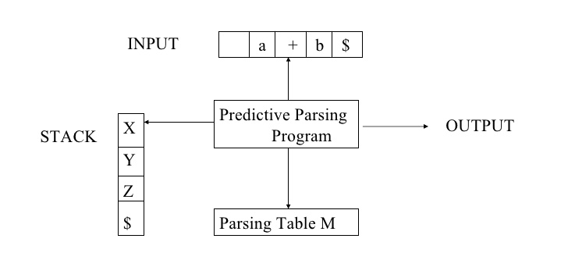

Slide 12
Predictive Parser
Knows which production to choose based on a lookahead symbol
Need LL(1) grammars
First L: left to right
Second L: leftmost derivation
1: one symbol lookahead
Has to be left-factored
Not all grammars can be made LL(1)

Slide 13
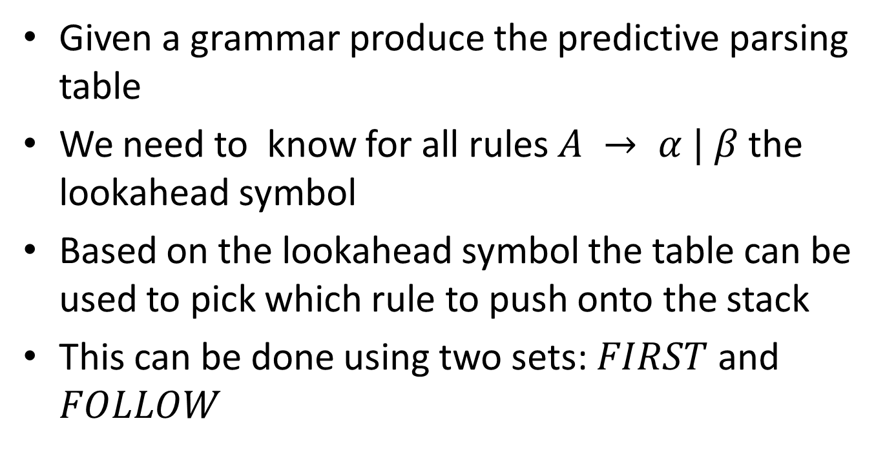
Predictive Parsing Table
Given a grammar produce the predictive parsing table
We need to know for all rules $A → α | β$the lookahead symbol
Based on the lookahead symbol the table can be used to pick which rule to push onto the stack
This can be done using two sets: $FIRST$ and $FOLLOW$

Slide 14
FIRST

Slide 15
Rules for First Sets
If X is a terminal then First(X) is just X.
If there is a Production X → ε then add ε to First(X)
If there is a Production X → Y1Y2..Yk then add First(Y1Y2..Yk) to First(X)
First(Y1Y2..Yk) is either
First(Y1) (if First(Y1) doesn't contain ε)
OR (if First(Y1) does contain ε) then First (Y1Y2..Yk) is everything in First(Y1) <except for ε > as well as everything in First(Y2..Yk)
If First(Y1) First(Y2)..First(Yk) all contain ε then add ε to First(Y1Y2..Yk) as well.

Slide 16
E → TE'
E' → +TE'
E' → ε
T → FT'
T' → *FT'
T' → ε
F → (E)
F → id
FIRST(E) = {}
FIRST(E') = {}
FIRST(T) = {}
FIRST(T') = {}
FIRST(F) = {}

Slide 17
E → TE'
E' → +TE'
E' → ε
T → FT'
T' → *FT'
T' → ε
F → (E)
F → id
FIRST(E) = {}
FIRST(E') = {}
FIRST(T) = {}
FIRST(T') = {}
FIRST(F) = {}
Rules:
First We apply rule 2 to T' → ε and E' → ε

Slide 18
E → TE'
E' → +TE'
E' → ε
T → FT'
T' → *FT'
T' → ε
F → (E)
F → id
FIRST(E) = {}
FIRST(E') = {ε}
FIRST(T) = {}
FIRST(T') = {ε}
FIRST(F) = {}
Rules:
First We apply rule 2 to T' → ε and E' → ε

Slide 19
E → TE'
E' → +TE'
E' → ε
T → FT'
T' → *FT'
T' → ε
F → (E)
F → id
FIRST(E) = {}
FIRST(E') = {ε}
FIRST(T) = {}
FIRST(T') = {ε}
FIRST(F) = {}
Rules:
First apply rule 2 to T' → ε and E' → ε
apply rule 3 to T' → *FT' this rule tells us that we can add everything in First(*FT') into First(T')

Slide 20
E → TE'
E' → +TE'
E' → ε
T → FT'
T' → *FT'
T' → ε
F → (E)
F → id
FIRST(E) = {}
FIRST(E') = {ε}
FIRST(T) = {}
FIRST(T') = {ε}
FIRST(F) = {}
Rules:
First apply rule 2 to T' → ε and E' → ε
apply rule 3 to T' → *FT' this rule tells us that we can add everything in First(*FT') into First(T'). First(*) using rule 1 is * . Also for E' → +TE'

Slide 21
E → TE'
E' → +TE'
E' → ε
T → FT'
T' → *FT'
T' → ε
F → (E)
F → id
FIRST(E) = {}
FIRST(E') = {+, ε}
FIRST(T) = {}
FIRST(T') = {*, ε}
FIRST(F) = {}
Rules:
First apply rule 2 to T' → ε and E' → ε
apply rule 3 to T' → *FT' this rule tells us that we can add everything in First(*FT') into First(T'). First(*) using rule 1 is * . Also for E' → +TE‘
Two more productions begin with terminals F → (E) and F → id If we apply rule 3

Slide 22
E → TE'
E' → +TE'
E' → ε
T → FT'
T' → *FT'
T' → ε
F → (E)
F → id
FIRST(E) = {}
FIRST(E') = {+, ε}
FIRST(T) = {}
FIRST(T') = {*, ε}
FIRST(F) = {`(`, id}
Rules:
First apply rule 2 to T' → ε and E' → ε
apply rule 3 to T' → *FT' this rule tells us that we can add everything in First(*FT') into First(T'). First(*) using rule 1 is * . Also for E' → +TE‘
Two more productions begin with terminals F → (E) and F → id If we apply rule 3
apply rule 3 to T → FT' once again this tells us that we can add First(FT') to First(T). Since First(F) doesn't contain ε that means that First(FT') is just First(F)

Slide 23
E → TE'
E' → +TE'
E' → ε
T → FT'
T' → *FT'
T' → ε
F → (E)
F → id
FIRST(E) = {}
FIRST(E') = {+, ε}
FIRST(T) = {`(`, id}
FIRST(T') = {*, ε}
FIRST(F) = {`(`, id}
Rules:
First apply rule 2 to T' → ε and E' → ε
apply rule 3 to T' → *FT' this rule tells us that we can add everything in First(*FT') into First(T'). First(*) using rule 1 is * . Also for E' → +TE‘
Two more productions begin with terminals F → (E) and F → id If we apply rule 3
apply rule 3 to T → FT' once again this tells us that we can add First(FT') to First(T). Since First(F) doesn't contain ε that means that First(FT') is just First(F).
Lastly we apply rule 3 to E → TE' once again this tells us that we can add First(TE') to First(E). Since First(T) doesn't contain ε that means that First(TE') is just First(T)

Slide 24
E → TE'
E' → +TE'
E' → ε
T → FT'
T' → *FT'
T' → ε
F → (E)
F → id
FIRST(E) = {`(`, id}
FIRST(E') = {+, ε}
FIRST(T) = {`(`, id}
FIRST(T') = {*, ε}
FIRST(F) = {`(`, id}
Rules:
First apply rule 2 to T' → ε and E' → ε
apply rule 3 to T' → *FT' this rule tells us that we can add everything in First(*FT') into First(T'). First(*) using rule 1 is * . Also for E' → +TE‘
Two more productions begin with terminals F → (E) and F → id If we apply rule 3
apply rule 3 to T → FT' once again this tells us that we can add First(FT') to First(T). Since First(F) doesn't contain ε that means that First(FT') is just First(F).
Lastly we apply rule 3 to E → TE' once again this tells us that we can add First(TE') to First(E). Since First(T) doesn't contain ε that means that First(TE') is just First(T)

Slide 25
FOLLOW

Slide 26
Rules for Follow Sets
First put $ (the end of input marker) in Follow(S) (S is the start symbol)
If there is a production A → aBb, (where a can be a whole string) then everything in FIRST(b) except for ε is placed in FOLLOW(B).
If there is a production A → aB, then everything in FOLLOW(A) is in FOLLOW(B)
If there is a production A → aBb, where FIRST(b) contains ε, then everything in FOLLOW(A) is in FOLLOW(B)

Slide 27
E → TE'
E' → +TE'
E' → ε
T → FT'
T' → *FT'
T' → ε
F → (E)
F → id
FOLLOW(E) = {}
FOLLOW(E') = {}
FOLLOW(T) ={}
FOLLOW(T') = {}
FOLLOW(F) = {}
Apply Rules
The First thing we do is Add $ to the start Symbol 'E'

Slide 28
E → TE'
E' → +TE'
E' → ε
T → FT'
T' → *FT'
T' → ε
F → (E)
F → id
FOLLOW(E) = {$,)}
FOLLOW(E') = {$}
FOLLOW(T) ={+}
FOLLOW(T') = {+}
FOLLOW(F) = {*}
Apply Rules
The First thing we do is Add $ to the start Symbol 'E‘
Next we apply rule 2 to E' →+TE' This says that everything in First(E') except for ε should be in Follow(T)
Next we apply rule 3 to E →TE' This says that we should add everything in Follow(E) into Follow(E')
Next we apply rule 3 to T → FT' This says that we should add everything in Follow(T) into Follow(T')
Now we apply rule 2 to T' →*FT' This says that everything in First(T') except for ε should be in Follow(F)
Now we apply rule 2 to F → (E) This says that everything in First(')') should be in Follow(E)

Slide 29
E → TE'
E' → +TE'
E' → ε
T → FT'
T' → *FT'
T' → ε
F → (E)
F → id
FOLLOW(E) = {$,)}
FOLLOW(E') = {$,)}
FOLLOW(T) = {+,$,)}
FOLLOW(T') = {+,$,)}
FOLLOW(F) = {*,+,$,)}
Apply Rules
Next we apply rule 3 to E → TE' This says that we should add everything in Follow(E) into Follow(E')
Next we apply rule 4 to E' → +TE' This says that we should add everything in Follow(E') into Follow(T) (because First(E') contains ε)
Next we apply rule 3 to T → FT' This says that we should add everything in Follow(T) into Follow(T')
Finally we apply rule 4 to T' → *FT' This says that we should add everything in Follow(T') into Follow(F)

Slide 30
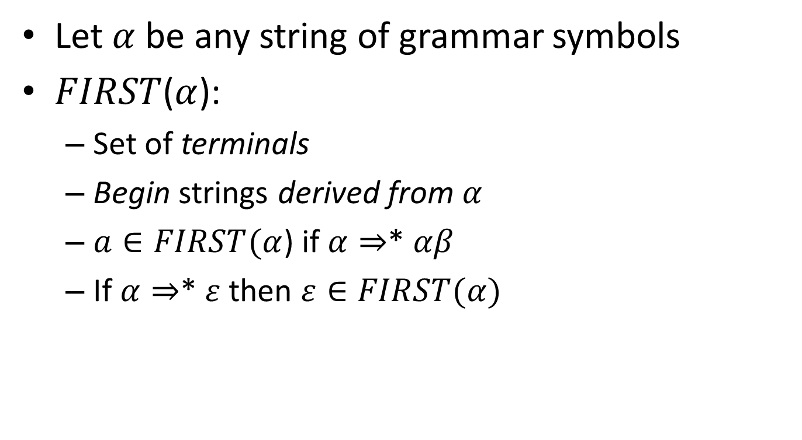
Thumb Rule: FIRST
Let $α$ be any string of grammar symbols
$FIRST$($α$):
Set of terminals
Begin strings derived from $α$
$a∈FIRST(α$) if $α⇒$* $αβ$
If $α⇒$* $ε$ then $ε∈FIRST(α)$

Slide 31
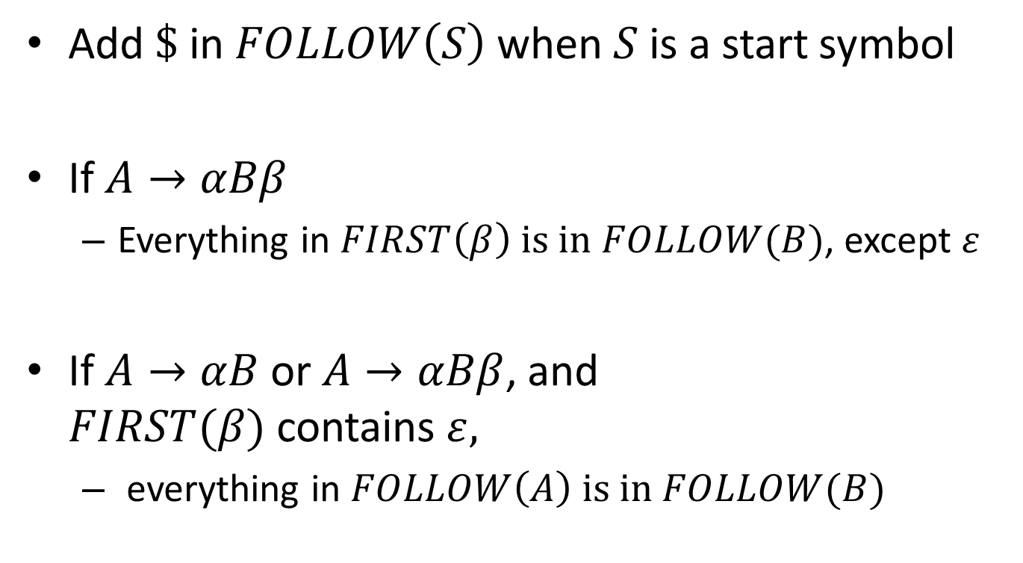
Thumb Rule: FOLLOW
Add $\$$ in $FOLLOW\left(S\right)$ when $S$ is a start symbol
If $A→αBβ$
Everything in $FIRST\left(β\right) is in FOLLOW(B)$, except $ε$
If $A→αB$ or $A→αBβ$, and $FIRST(β)$ contains $ε,$
everything in $FOLLOW\left(A\right) is in FOLLOW(B)$

Slide 32
Outline
Left Recursion
Elimination
Left factoring
Predictive Parsing
First and Follow
Construction of Parse Table
Predictive Parsing Example

Slide 33
Predictive Parsing Table
Predictive parsers can be constructed from LL(1) grammar
Predictive parsing table is used
to choose the next production for a particular input symbol
based on the information stored in the table

Slide 34
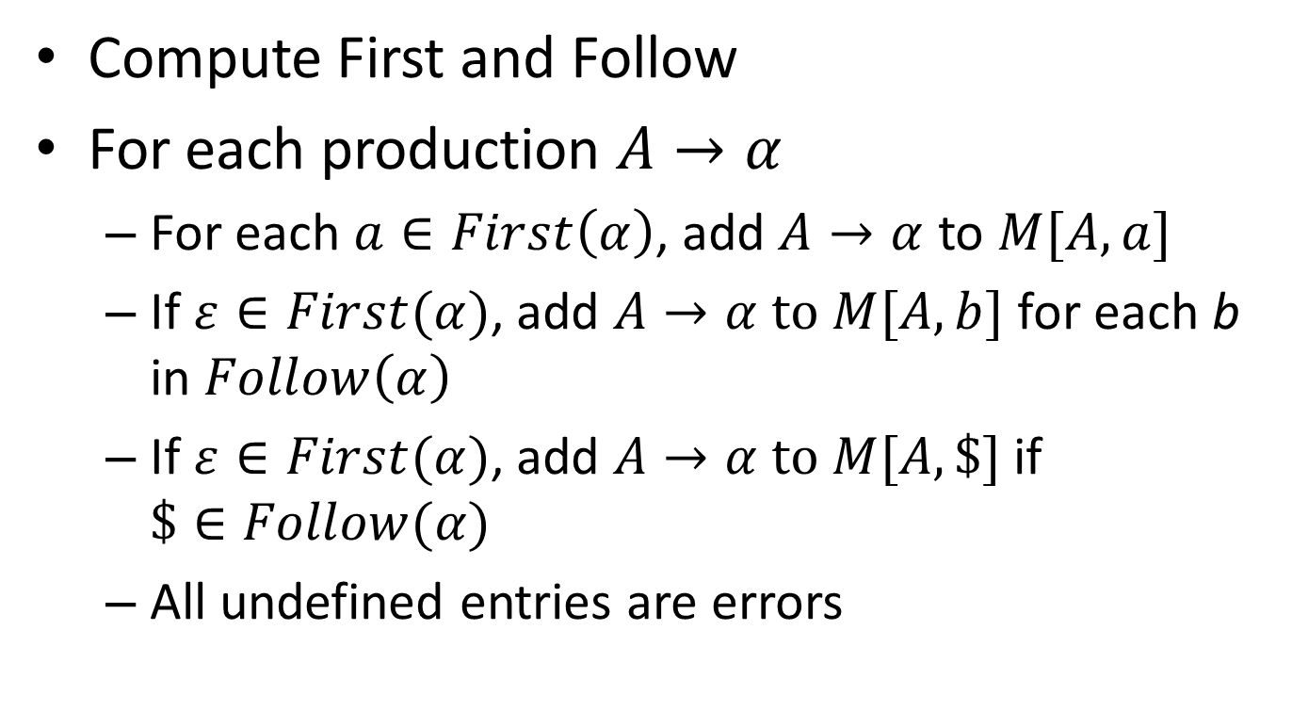
Building Parse Table
Compute First and Follow
For each production $A→α$
For each $a∈First\left(α\right)$, add $A→α$ to $M[A,a]$
If $ε∈First(α)$, add $A→α to M[A,b]$ for each b in $Follow\left(α\right)$
If $ε∈First(α)$, add $A→α to M[A,\$]$ if $\$∈Follow(α)$
All undefined entries are errors

Slide 35
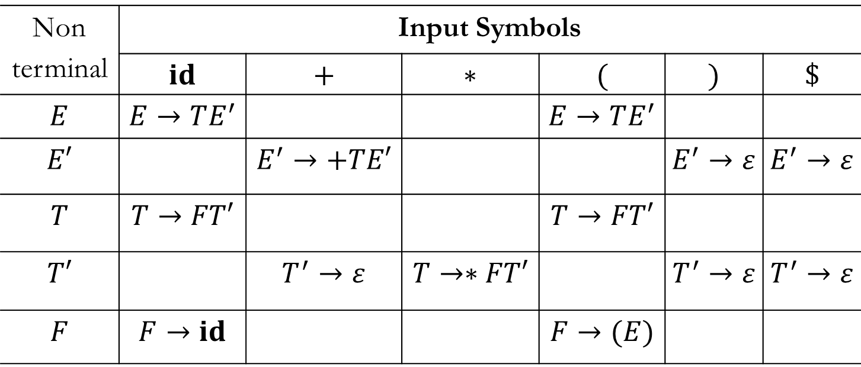
Parsing Table
Non terminal | Input Symbols
 | $$id$$ | $$+$$ | $$∗$$ | $$($$ | $$)$$ | $$\$$$
$$E$$ | $$E→TE^{′}$$ |  |  | $$E→TE^{′}$$
$$E′$$ |  | $$E^{′}→+TE′$$ |  |  | $$E^{′}→ε$$ | $$E^{′}→ε$$
$$T$$ | $$T→FT′$$ |  |  | $$T→FT′$$
$$T′$$ |  | $$T^{′}→ε$$ | $$T→∗FT′$$ |  | $$T^{′}→ε$$ | $$T^{′}→ε$$
$$F$$ | $$F→id$$ |  |  | $$F→(E)$$

Slide 36
Outline
Left Recursion
Elimination
Left factoring
Predictive Parsing
First and Follow
Construction of Parse Table
Predictive Parsing Example

Slide 37
LL(1) Parser: Example
Stack | Input | Output
$E | id + id * id $

Slide 38
LL(1) Parser: Example
Stack | Input | Output
$E | id + id * id $
$E’T | id + id * id $ | E → TE’

Slide 39
LL(1) Parser: Example
Stack | Input | Output
$E | id + id * id $
$E’T | id + id * id $ | E → TE’
$E’T’F | id + id * id $ | T → FT’

Slide 40
LL(1) Parser: Example
Stack | Input | Output
$E | id + id * id $
$E’T | id + id * id $ | E → TE’
$E’T’F | id + id * id $ | T → FT’
$E’T’id | id + id * id $ | F → id

Slide 41
LL(1) Parser: Example
Stack | Input | Output
$E | id + id * id $
$E’T | id + id * id $ | E → TE’
$E’T’F | id + id * id $ | T → FT’
$E’T’id | id + id * id $ | F → id
$E’T’ | + id * id $ | match id

Slide 42
LL(1) Parser: Example
Stack | Input | Output
$E | id + id * id $
$E’T | id + id * id $ | E → TE’
$E’T’F | id + id * id $ | T → FT’
$E’T’id | id + id * id $ | F → id
$E’T’ | + id * id $ | match id
$E’ | + id * id $ | T’ → ε

Slide 43
LL(1) Parser: Example
Stack | Input | Output
$E | id + id * id $
$E’T | id + id * id $ | E → TE’
$E’T’F | id + id * id $ | T → FT’
$E’T’id | id + id * id $ | F → id
$E’T’ | + id * id $ | match id
$E’ | + id * id $ | T’ → ε
$E’T+ | + id * id $ | E’ → +TE’

Slide 44
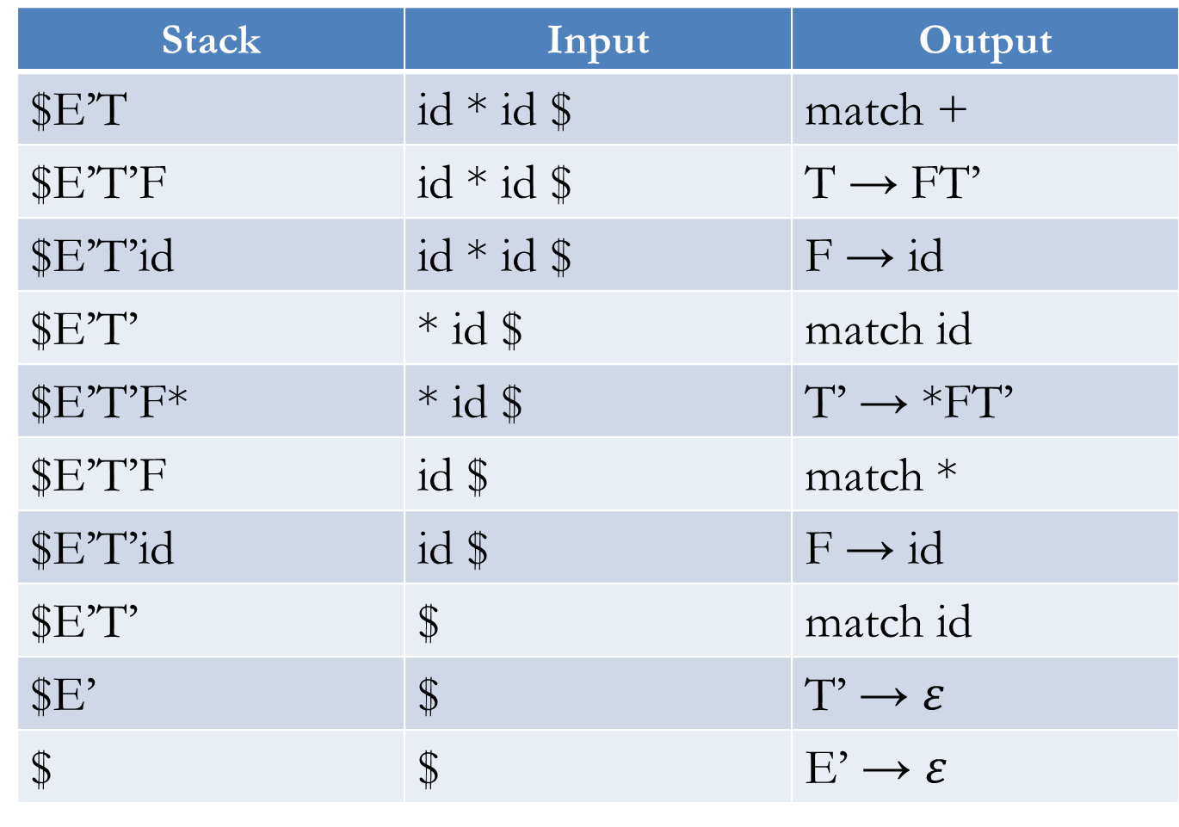
Stack | Input | Output
$E’T | id * id $ | match +
$E’T’F | id * id $ | T → FT’
$E’T’id | id * id $ | F → id
$E’T’ | * id $ | match id
$E’T’F* | * id $ | T’ → *FT’
$E’T’F | id $ | match *
$E’T’id | id $ | F → id
$E’T’ | $ | match id
$E’ | $ | T’ → $ε$
$ | $ | E’ → $ε$

Slide 45


